Slide 1
Asteroid Occultation Predictions What are they and where do you get ‘em
Steve Kerr

Slide 2
Asteroid Occultations
From IOTA Observers Manual

Slide 3
What is Predicted?
Star and Asteroid/Planet identification
Path location and width
Time of occultation along the path – appulse time
Duration of occultation at maximum chord length
Magnitude drop (delta mag, Δmag)
Some reference to uncertainty (sometimes)

Slide 4
Sources of Predictions
Edwin Goffin
Steve Preston
Bruno Sicardy
DIY with Occult
Occultwatcher to bring them all together

Slide 5
Edwin Goffin Predictions
Long running program of predictions
Restricted to objects with reasonably well established orbits
Produced long before events
Available through RASNZ Occultation Section website – www.occultations.org.nz
Go to Asteroid Predictions page and follow link from asteroid name - http://www.occultations.org.nz/planet/2014/planoc14.htm

Slide 7
Edwin Goffin Predictions
Information on occulting asteroid or planet
Information on occulted star
Wide field finder chart – RASNZ Occsec members add chart details
Time at the heading is closest approach to the centre of the Earth – not for any particular place on Earth.
Read time off the path markers
Watch our for low Δmag events – highlighted in this example.
No information about prediction uncertainty – the dotted line on the map is the 1 second of arc parallax line.

Slide 8
Updated Path
Mostly done by Steve Preston, Washington, USA.
Incorporating most recent observations of occulting asteroid
Sometimes refinement of star position with more recent data
Available a number of weeks ahead
Can be multiple updates for any given event
Incorporates uncertainty in path location – Concept of Rank and 1-σ deviation lines
Email distributed by RASNZ Occsec at the start of each month – Short summary of updated events, approximate path and link to update page.

Slide 9
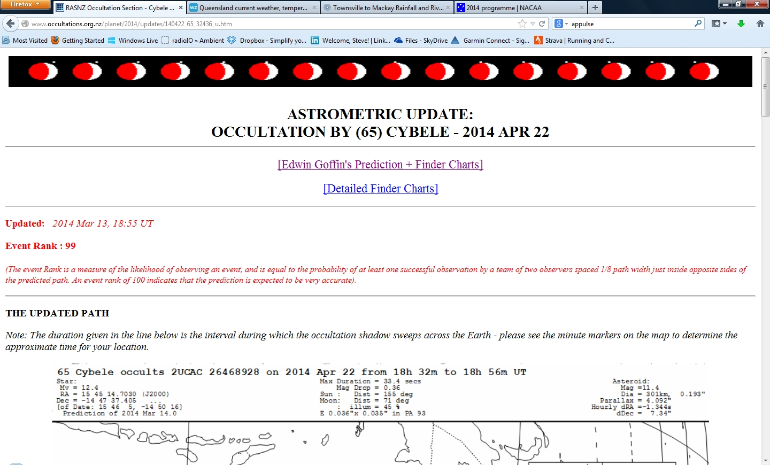

Slide 10
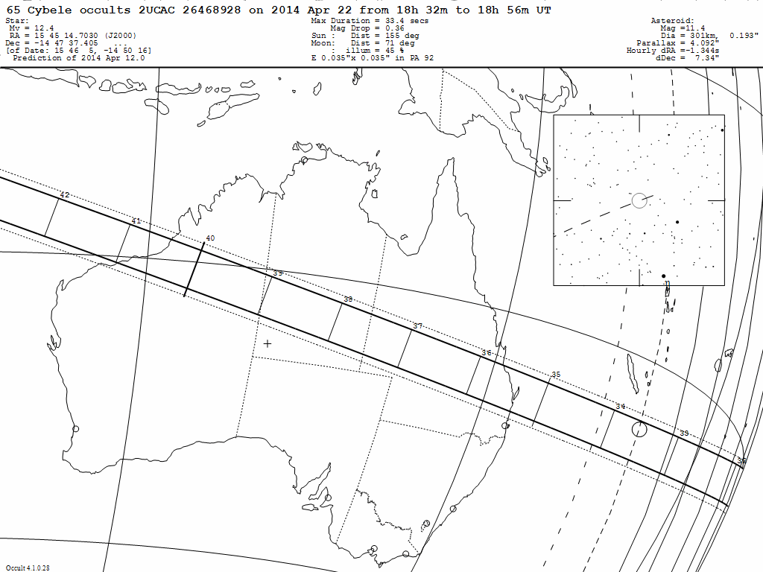

Slide 11
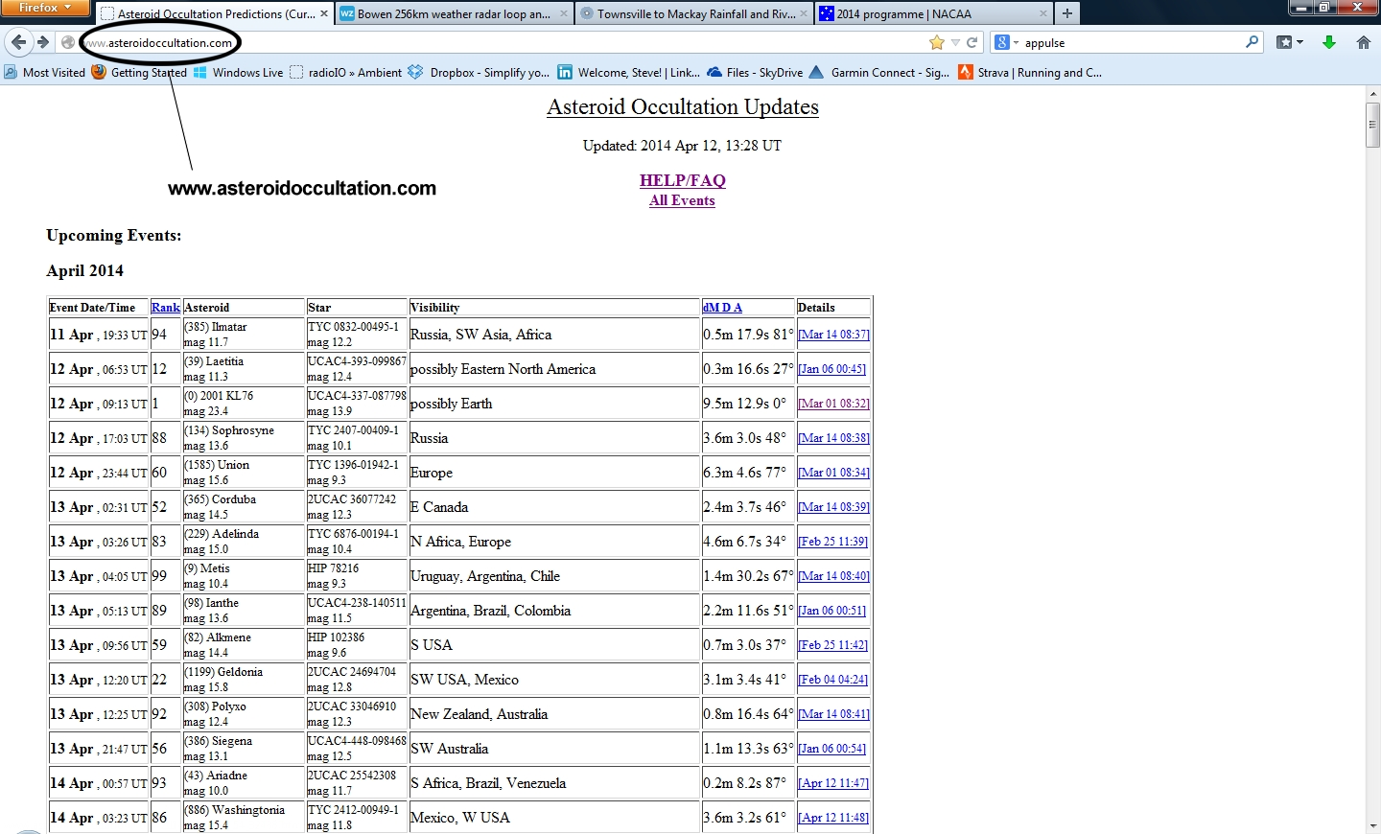

Slide 12
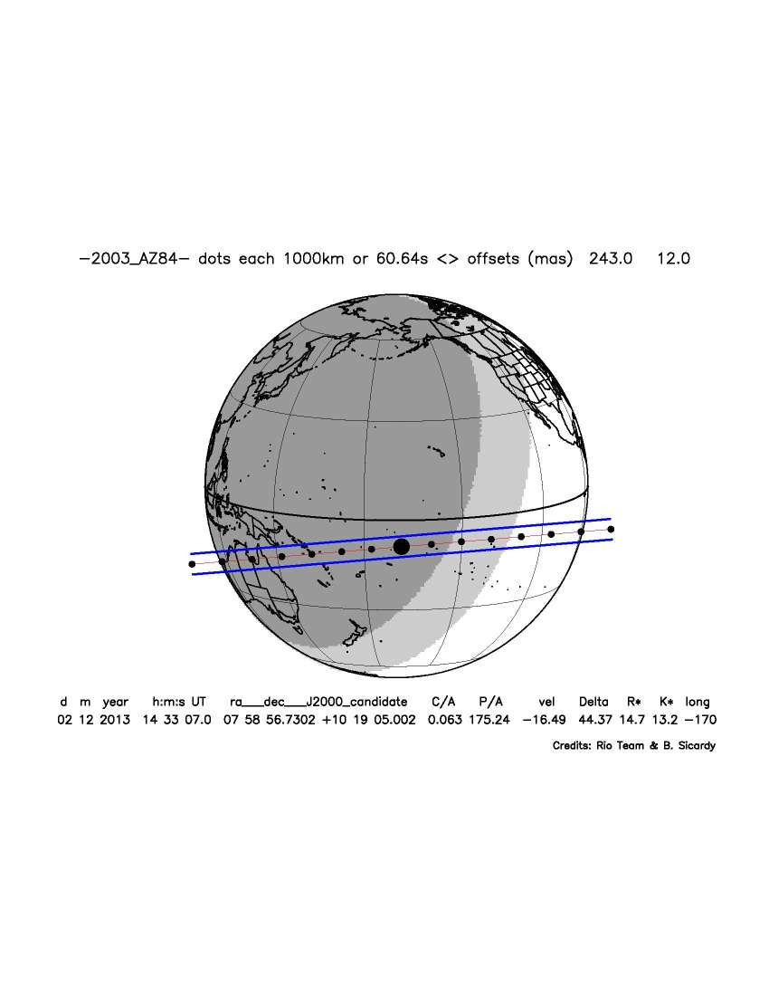
RIO Group/Bruno Sicardy
http://www.lesia.obspm.fr/perso/bruno-sicardy/
Special interest program in TNO’s and satellites of Pluto
Cover professional programs – lots of very faint stars for very large telescopes
Not sorted by region – its a global program!
More in Dave Gault’s talk on Monday

Slide 13
DIY with Occult
Download recent orbital elements for asteroids and combine with recent star catalogue in Occult to make your own predictions
Will turn up many of the same events – but probably not quite as precisely due to lack of access to elements that Steve Preston brings
Sometimes digs up obscure/challenging events – faint stars or very low Δmag events otherwise missed.
Not really something for beginner observers

Slide 14
OccultWatcher
A Windows software package that gathers occultation predictions from various sources and presents them in a standardised format
Gives the time and probability of event for your location
Filters events for a personalised set of parameters
Star brightness
Distance from ‘home’
Star altitude and azimuth – gives you an idea if those trees are going to be a problem
Moon and twilight information for your location and time
Allows coordination between observers
‘Add ins’ allow generation of finder charts with C2A
http://hristopavlov.net/

Slide 15
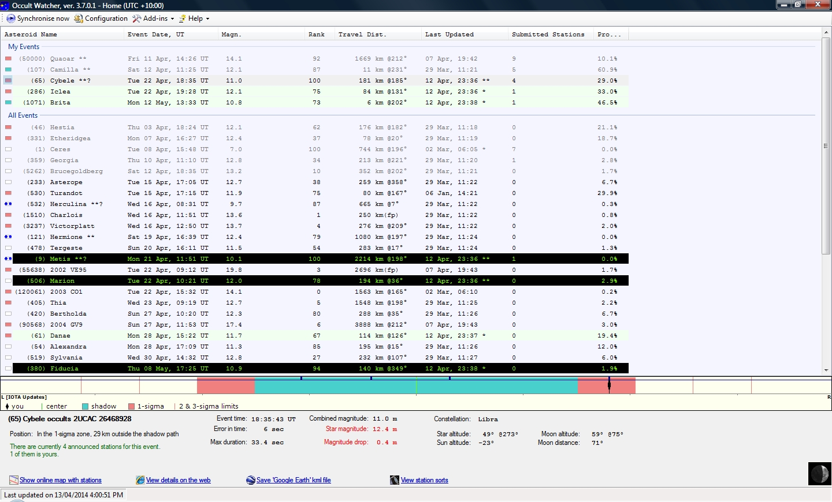

Slide 16
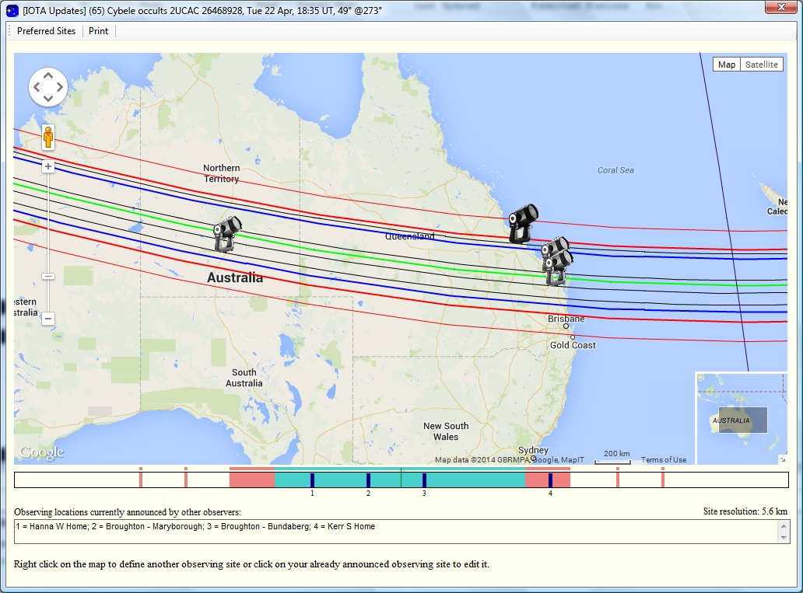

Slide 17
Questions?

